Slide 1
Traditional Japanese Restaurant in USA

Slide 2
Introduction
My best friend "Aya", the young Japanese lady just graduated from university have plan to marry with her partner and will be moved to New York City after married because her partner working there as a business man. Aya has her dream to open up her own Japanese restaurant and this is a chance to open her own restaurant in the amazing place New York City!

Slide 3
Business Problem
Aya doesn't have any idea because she doesn't know anything about New York. The important thing she has to do is exploring about New York before doing her Business Plan.

Slide 4
Describe the data that will be using to execute the idea
Based on definition of my idea, factors that will influence my decission are:
- the type of common area in the neighborhood (any type)
- find out there are any Japanese restaurants in the neighborhood ( if any)
- distance of neighborhood from city center I decided to use regularly spaced grid of locations, centered around city center, to define our neighborhoods.

Slide 5
Describe the data that will be using to execute the idea
Following data sources will be needed to extract/generate the required information:
- Centers of candidate areas will be generated algorithmically and approximate addresses of centers of those areas will be obtained using New York Data that already used by previous lab.
- Number of restaurants and their type and location in every neighborhood will be obtained using Foursquare API

Slide 6
Neighborhood Candidates
Create latitude & longitude coordinates for centroids of candidate neighborhoods.
- first, I will explore the New York City
- then explore Manhattan, the area that Aya's partner house is located in.

Slide 7
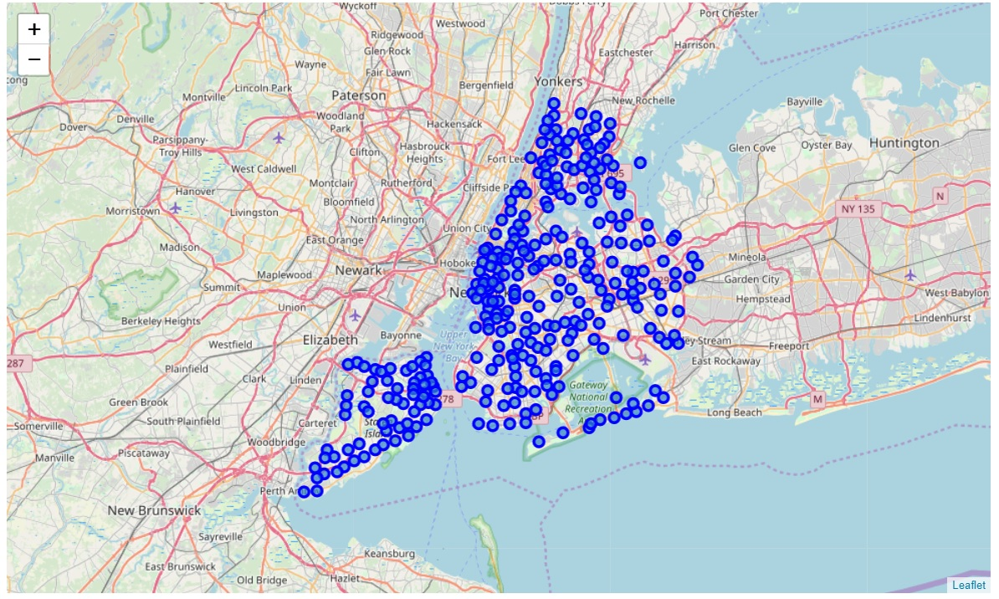
A map of New York with neighborhoods

Slide 8
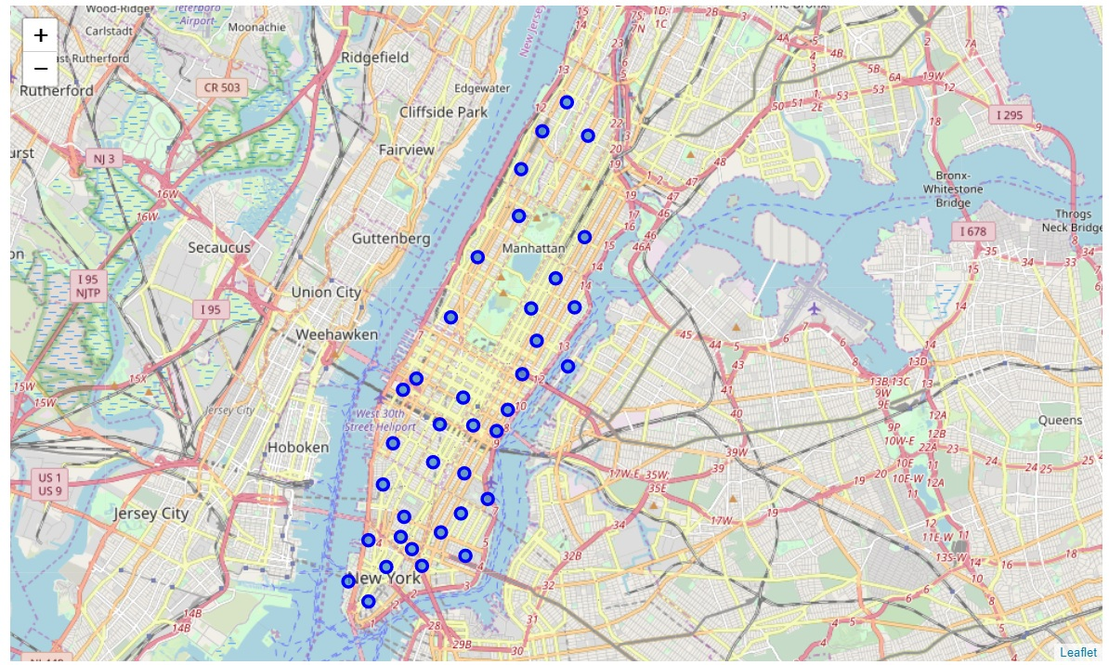
A map of New York with neighborhoods

Slide 9
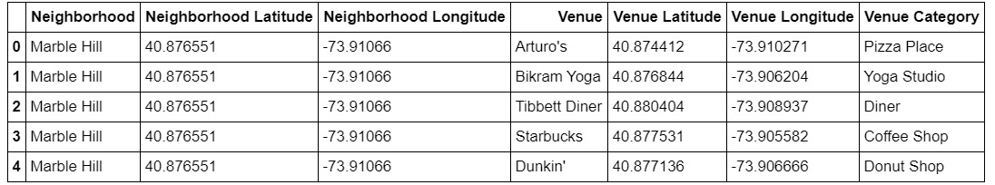
Next, utilizing the Foursquare API to explore the neighborhoods and segment them. Then put on the data frame.

Slide 10
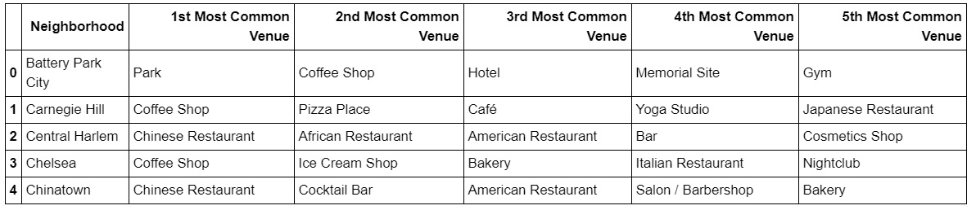
Drop the duplicate categories, there are 334 unique categories in Manhattan. Then, create the new data frame and display the top 5 venues for each neighborhood

Slide 11
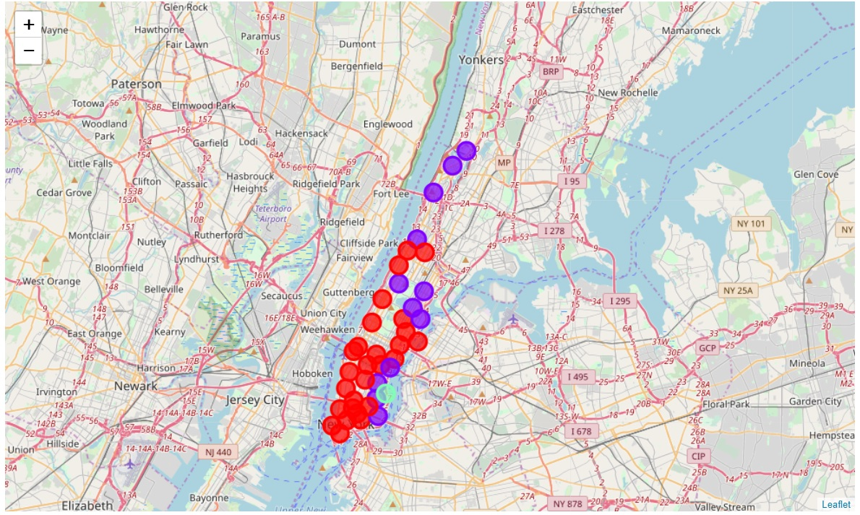
Cluster the neighborhood into 3 clusters and plot to Manhattan map.

Slide 12
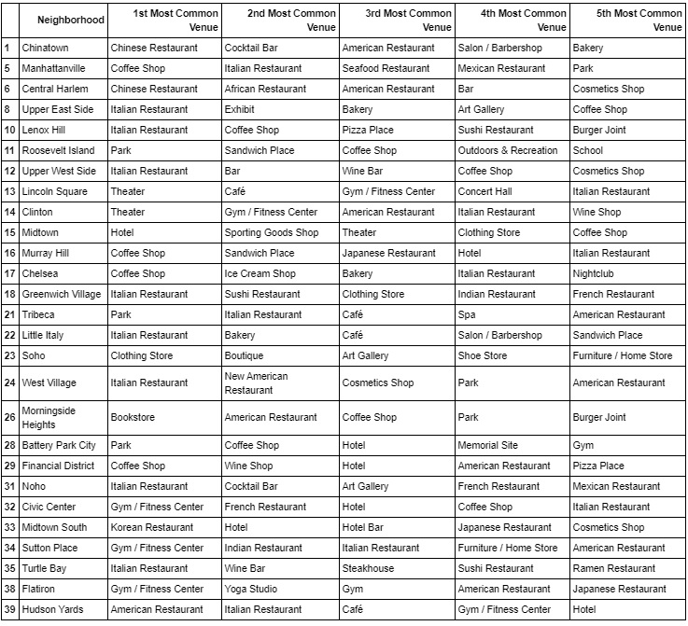
Cluster 1

Slide 13
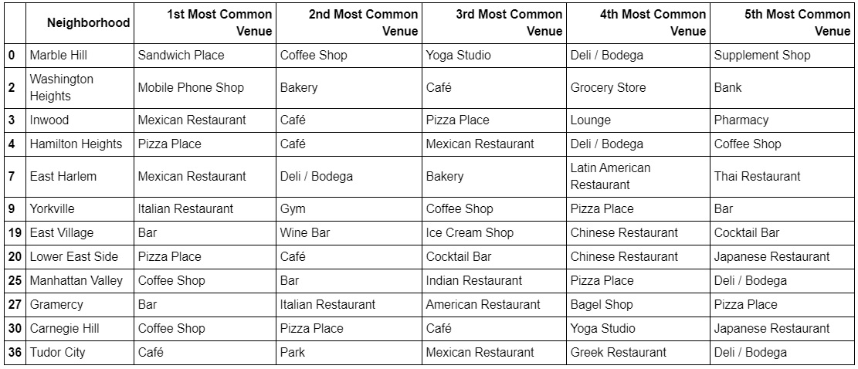
Cluster 2

Slide 14
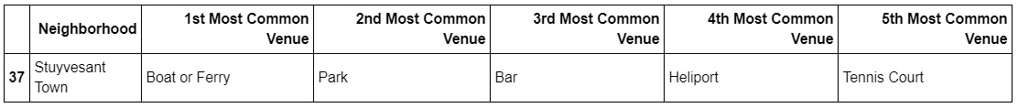
Cluster 3

Slide 15
Results and Discussion
This analysis shows about 3 groups of area around Manhattan, New York, USA. Each cluster groups show the top 5 common venue of each area to bring the idea which area Aya should open her Japanese restaurant.
Result of all this is 40 area containing largest number of potential new restaurant locations based on number of ranking of each area. Cluster 1 is the popular location and contain the large rating of restaurant-categories. Cluster 2 is also contain rating of restaurant-categories, but mostly are light meal or beverages. Cluster 3 is no contain any restaurant type.
If I would recommend Aya, I will suggest the area in Cluster 1 to open her restaurant.

Slide 16
Conclusion
Purpose of this project is to recommend Aya to open her Japanese restaurant in the right place! As you can see on the result of each cluster, the area in cluster 3 "Stuyvesant Town" is very near from her partner's house. If she thinks only where is the most convenience for her to take care the restaurant, she may choose the nearest one! And she might loss the potential to run the business and she will get loss for sure.
Finally, I would like to suggest her to survey the area of “Cluster 1” that will open the restaurant by herself.

